Slide 2
What Makes Us Different:
The Three Pillars of Auto Butler

Slide 3
Program Highlights
Great front-end profits, $1295 per program sold
Up to 9 prepaid customer return appointments
5 year warranty protection
Consistent, quality results from our automated
application process
Monthly sales training & on-site support
Optional: and complete car wash system
Chemicals, parts, & maintenance included

Slide 4
Guaranteed Profits

Slide 5
Increased Profits
Average Auto Butler Dealer has 40% penetration rate if a new car sales
Auto Butler is a tangible valued product
Management fee/dealer accrual/over remittance
Offer single application sales out of service drive
Preload Auto Butler inventory for secured profit

Slide 6
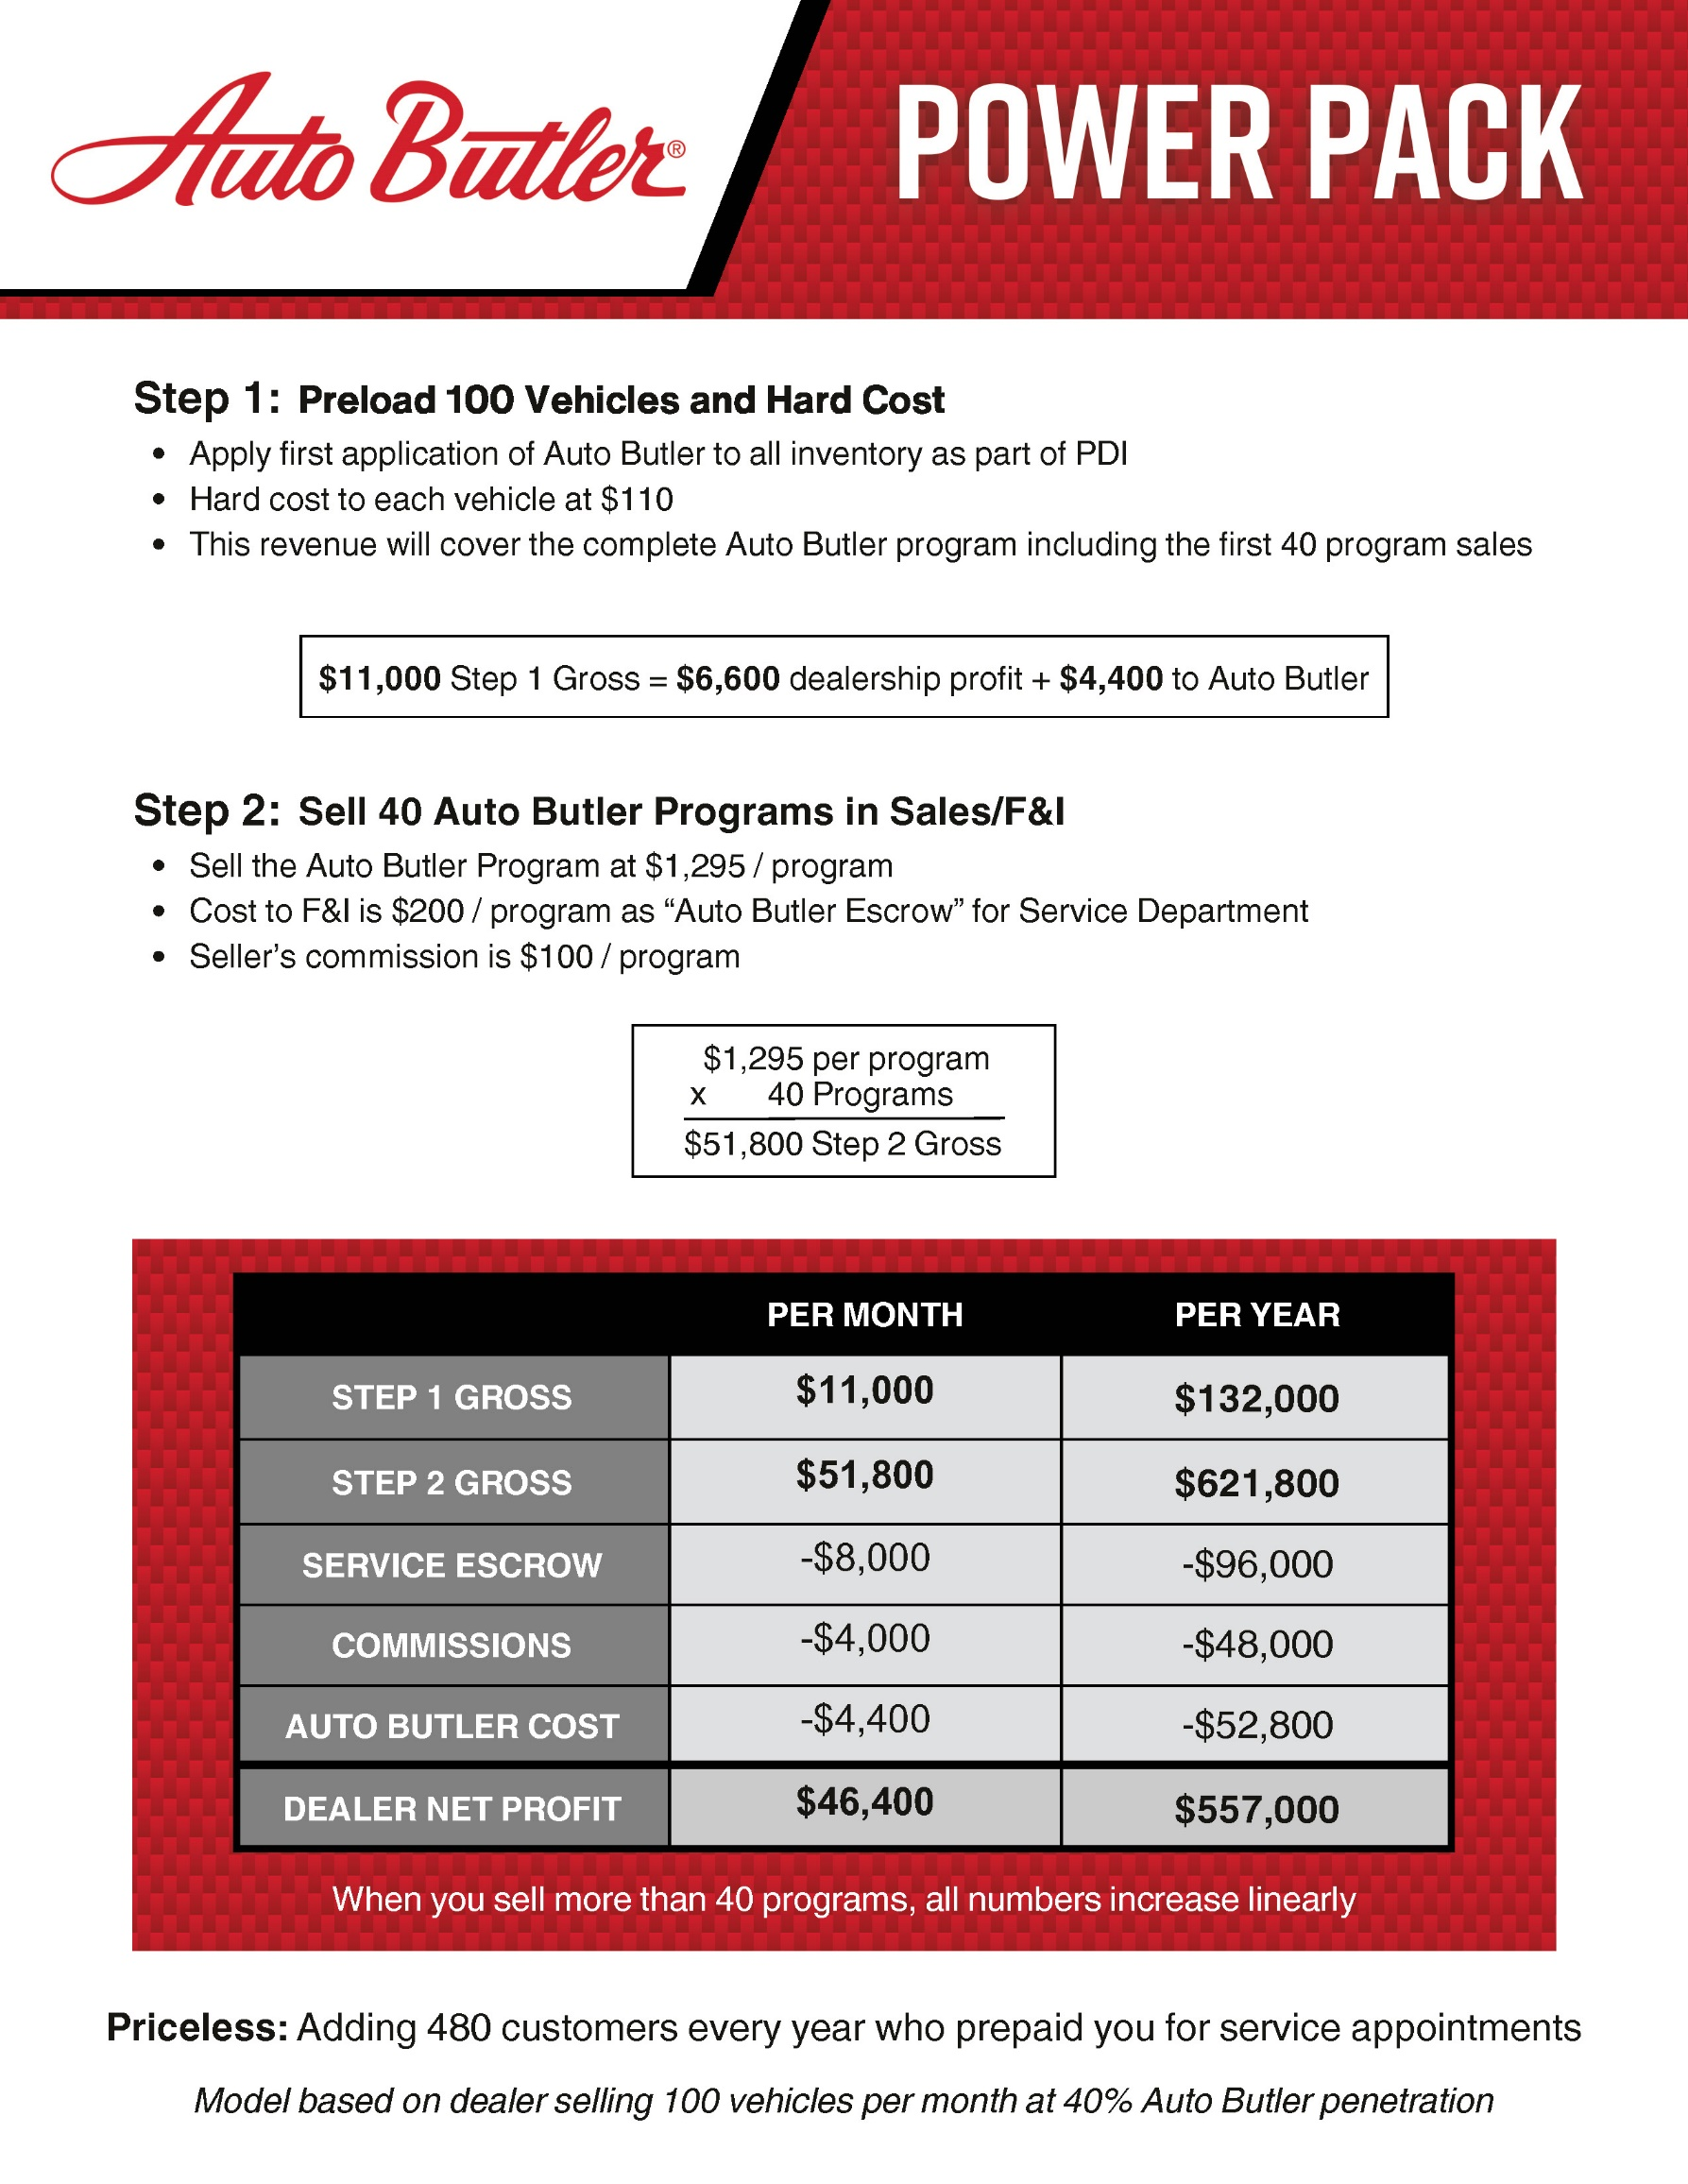
$1,295 per program

Slide 7
Auto Butler is a Coverage Charge to Visit Your Dealership
9 Returning Customer Visits

Slide 8
Service Retention:
More Touch Points Equals Stronger Loyalty
50% of dealerships identify service department as their largest opportunity of growth - DealerSocket
Service retention sells cars - bottom line
Strongest opportunity to upgrade/trade in vehicles when customers visit for service
5% increase in customer retention equates to average of 50% profit increase - Forbes
38% of new car sales customers might return for their first service visit if the first appointment isn’t set, 57% will return if they do - Drive Sure
70% of customers who purchased their car at a dealership did not return for service in the last year - Cox Automotive
40 programs sold per month during the agreement equals to 12 additional RO’s per day
ARO equals $5,700/day or $148,200/month

Slide 9
Automated Process
Huge labor savings due to drastically rising labor rates
Preloading Auto Butler Protection is cost effective for both new and used vehicles
Unlimited chemicals and polisher usage at no charge
Utilize polisher for handling heat cases/promotions
All maintenance and cleaning included
Auto Butler is an original ceramic coating with a two step process

Slide 13
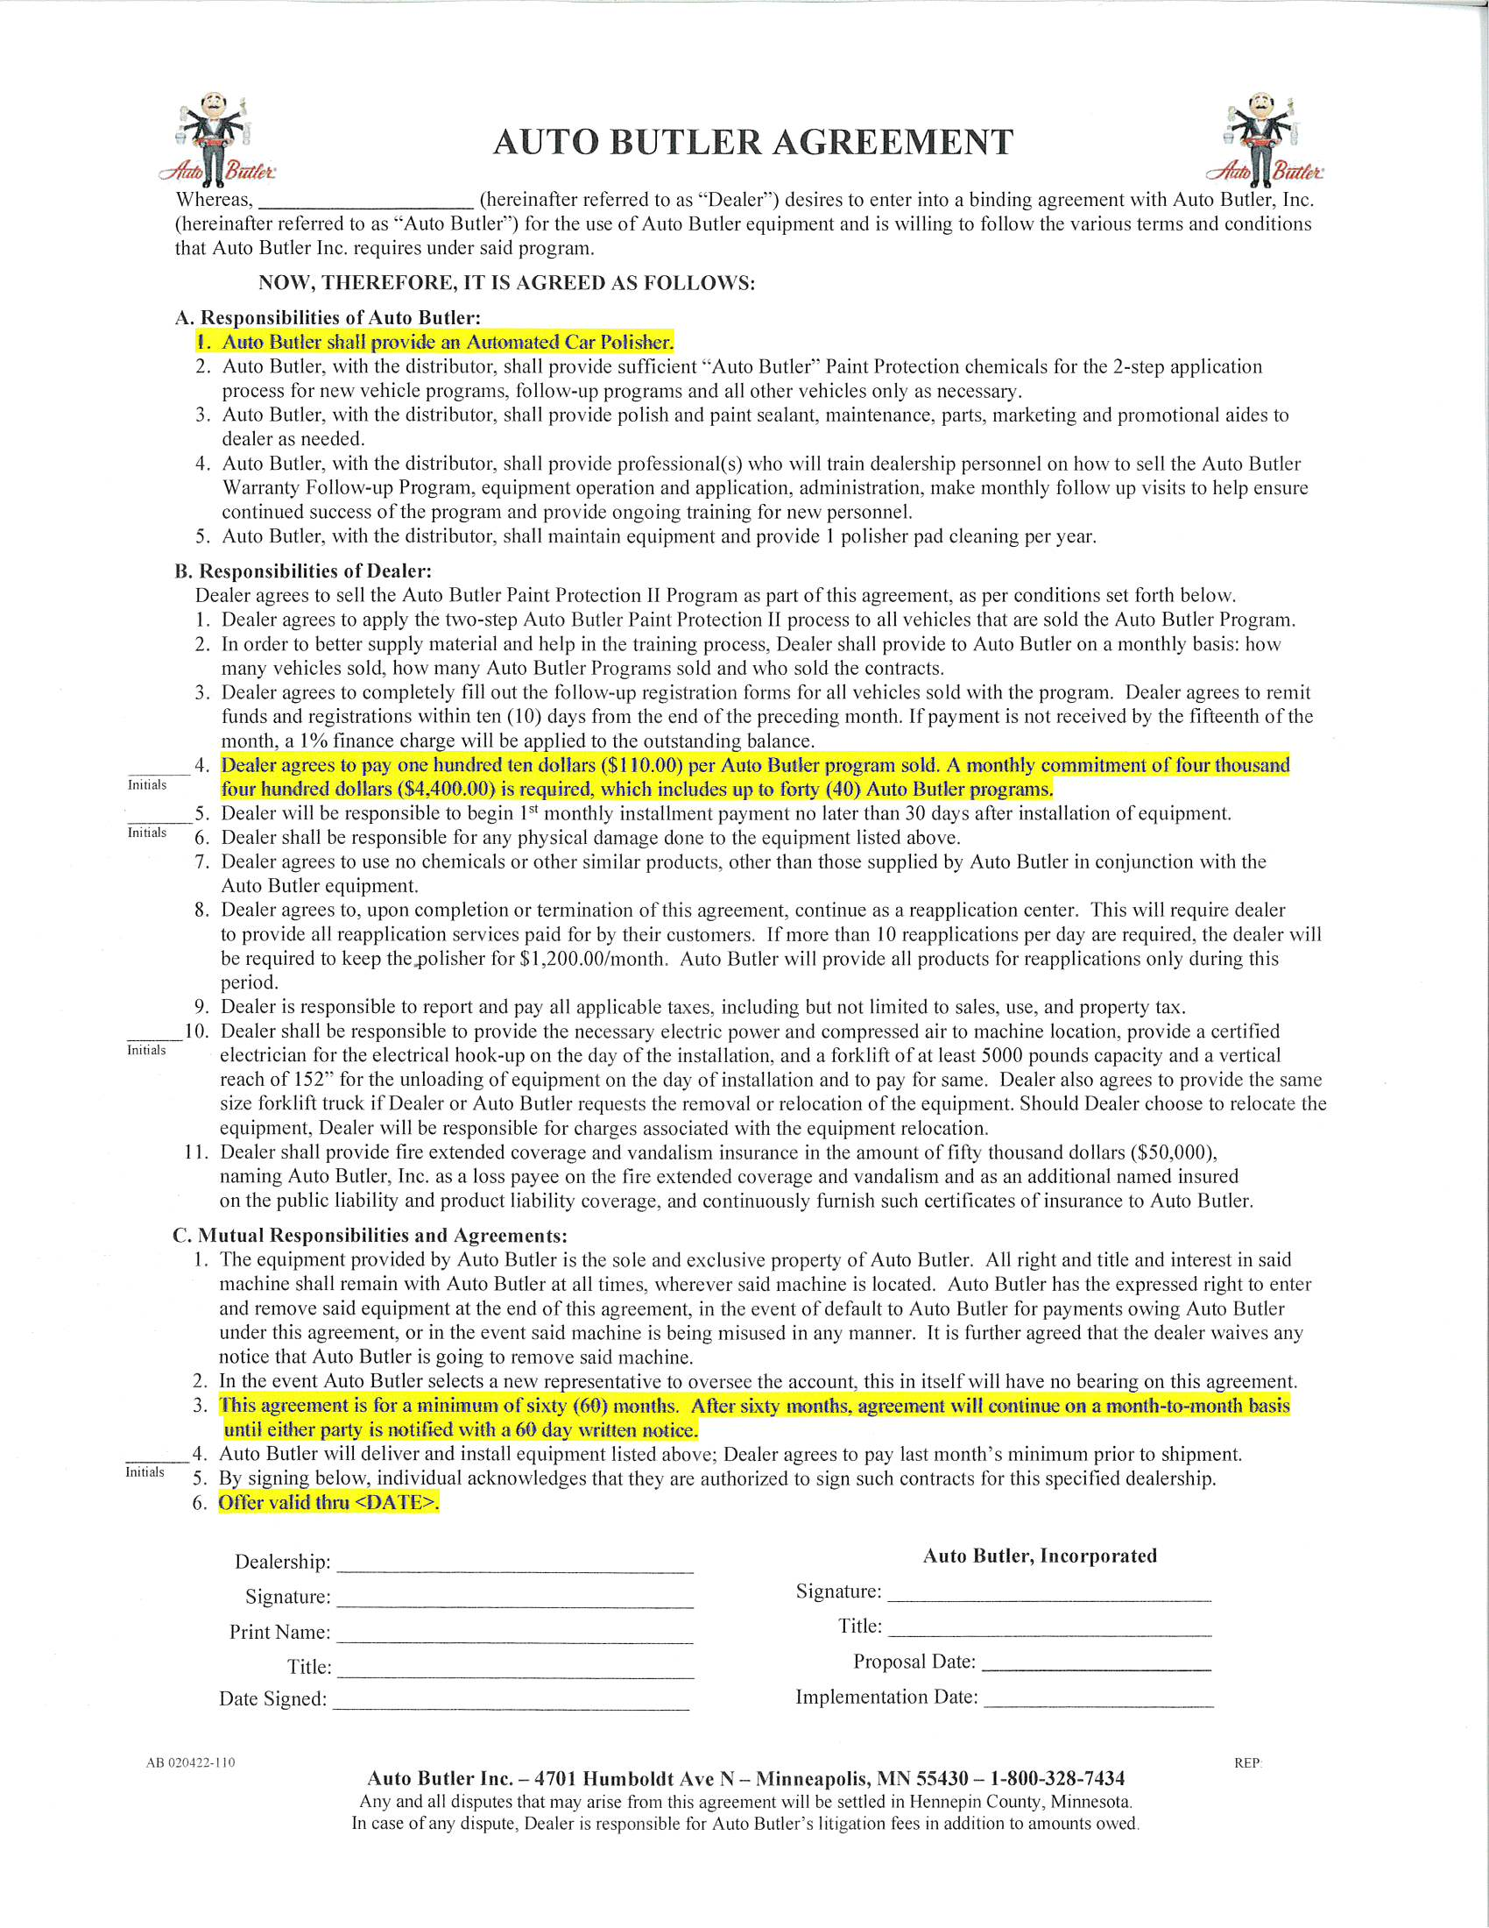

Slide 14
POLISHER INSTALLATION

Slide 15
Driving Customer Loyalty and Profits Through Exceptional Service Experiences
“Customer For Life”

Slide 16
Thank You!

Slide 17
Everyone Wins With Auto Butler
Customer
Dealership Sales Department
Dealership Service Department

